Slide 1
WINEMAKING -
AN "ENARTISTS" APPROACH

Slide 2
discussion Outline
How did I get here?
Overview of Winemaking Price
Common Challenges at Each Phase
Important Considerations.
Along the Way…
Things I know Now, That Would Have Been Nice to Know Way Back When…
Blending Art & Science To Create Something Magical That Touches Our Soul
The Winemaker's Spice Rack & Tool Box –
We Are Chefs of the Ultimate "Slow Food".
Q & A
Notes:
How did I get here? I will briefly discuss my background. Because, as I look back on my life and the path that got me to where I am today, I realize that I didn't get here by accident. It allows me to build the foundation of what I will be discussing with you this evening.
Overview of Winemaking Process: I understand that everyone here has different levels of experience, so I will extremely briefly go over the winemaking process. As I do this, I will touch on common challenges at each stage, how to deal with those challenges, and; point out some important considerations to keep in mind at each stage of the process.
Along the way: As we go down this journey, I will be giving you some golden nuggets of information. Many of which are important things to now that doesn't get talked about much, or common misconceptions, etc.
My approach to winemaking is to blend my technical/science side (left brain if you will) with my creative artistic side - think outside the box – right brain
The Winemaker's Spice Rack and Tool Box: finally if we have time, I would like to touch on what I consider to be the winemaker spice rack and toolbox. There is a kind of taboo about talking about why you making products and techniques. I would like to remove the veil, lift the curtain and just talk to you about what some of these common treatment materials are, why we use them in the industry, how they work, what they do and show you that its ok if you choose to use them, it doesn't make you less of a winemaker.

Slide 3
Mike's Background
Started working at Rest. @ 14yrs.
College = JWU (A.S.) & FIU (B.S.)
2005 Moved to CA
Made homemade wine from 2006 - 2012
2012: left rest. Biz for Wine Biz. At DRW
2013: l was hired at WineSmith Wines & Consulting
2013 Started wine label: Engracia Wines
2017: Hired at Enartis as TSR
2018: Daughter born / 2019 – closed down EW.
Notes:
- First job at 14, not b/c I needed to, but b/c I wanted too. Owned by my dad's friend, We would visit and check on the progress, I Watched it get built, from ground up, thoughtnit was so cool, okingly asked for a job and he said yes. I worked Fri & Sat. nights from 6 -10 PM. Saved money to buy my first guitar from the guitarist that was in the Blues Band that would play there every weekend.
Kept working in restaurantsfrom then and throughout high school, I really enjoyed it. Went to college and got my A.S. from JWU for C.A. Continued my studies and graduated from FIU with a B.S. in Hosp. Rest. Mngmt. I took 3 wine classes at FIU and my Professor became a good friend and mentor to me. He encouraged me to move to CA. He would always tell me; "Mike, Sonoma County is where you need to be". Once I graduated in Spring of 2005, I packed up as much as I could in my little ol' Acura, and drove out to Sebastopol.
I managed restaurants in Sonoma, Napa, Mendocino and Marin counties between 2005 – 2012. All the while was making wine at home
2012 went to work at DRW
2013- Hired by WineSmith Wines & Consulting
2014 Started label Engracia Wines and made my wines CC at DRW.
2017 – Poached and Hired by Enartis USA.
-2018 Ava born and
-2019 closed down Engracia Wines – Priorities shifted, had to come to terms with my ego. I still make wine and cider every year for personal consumption and a few clients that grow grapes on their property, butdon't want to make the wine. And here I am.

Slide 4
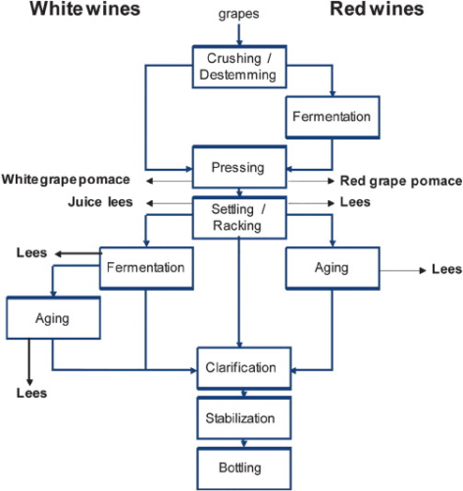
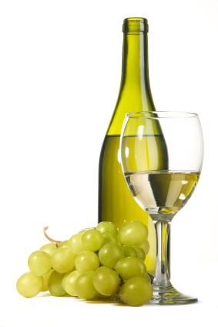
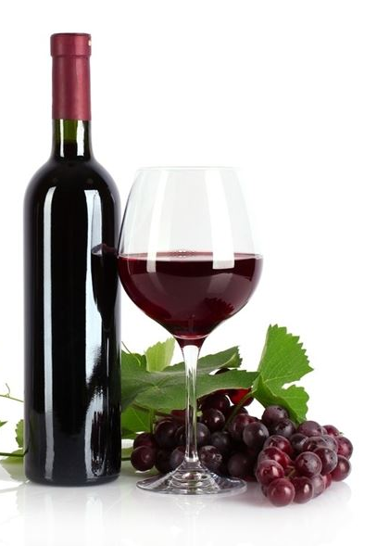
Winemaking Process
Notes:
- Harvest/Crus/Destem –skins can break and allow unwanted spoilage organisms to get in the fruit – Acetobacter Pediococcus, lactobacillus. These give off aromas and flavors- Protect wit SO2.

Slide 5
Picking decisions

Slide 6
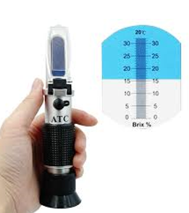
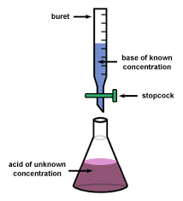
Picking decisions to consider
pH
Acidity
Brix
Berry Maturity
TASTE!!!
Notes:
Brix should not be the sole indicator of picking deciions. For sure it is one of them, but we must lso consider:
pH
Acidity
Brix
Pulp
Skin texture, favor, and color is red wine
Berry color

Slide 7
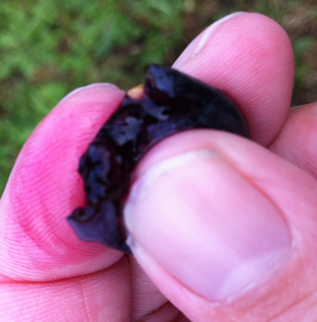
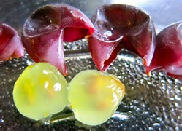
Picking decisions to consider besides Brix
Detachment of Pulp
Put 5 berries in your mouth
Extract the pulp by crushing successively each berry
Evaluate pulp detachment
Evaluate juiciness
Spit out skins into hand and keep them
Spit out seeds and keep them
Berry color
Notes:
Brix should not be the sole indicator of picking deciions. For sure it is one of them, but we must lso consider:
pH
Acidity
Brix
Pulp
Skin texture, favor, and color is red wine
Berry color

Slide 8
Grape Sampling Guidelines
1
2
3
Taste
Taste berries as you go
Seeds
Look at seeds
1 = yellow - green = NOT RIPE
2 = green - brown = APPROACHING RIPENESS
3 = dark brown = RIPE
Take Notes
Make some brief notes
Grape flavors
Sweetness
Acid
Overall maturity
Problem areas
Pest or disease issues

Slide 9
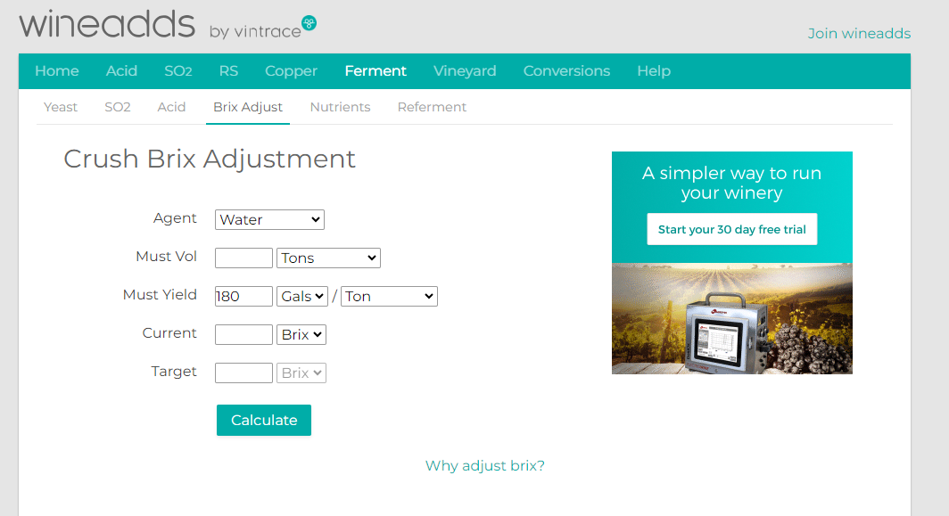
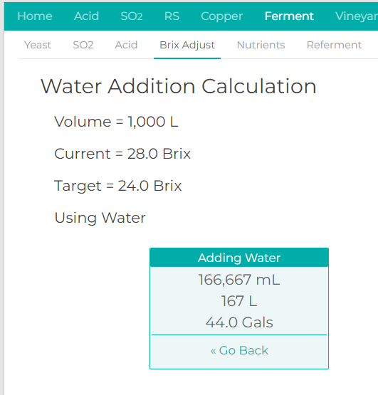
YOU CAN ALWAYS ADD WATER…
Best if done at juice stage
You'll never notice a difference
Wait at least 24 hours after crush
Use Chlorine Free Water
You will dilute the acid so, you need to acidulate the water with tartaric
pH is NOT affected.
Notes:
Brix should not be the sole indicator of picking deciions. For sure it is one of them, but we must lso consider:
pH
Acidity
Brix
Pulp
Skin texture, favor, and color is red wine
Berry color

Slide 10
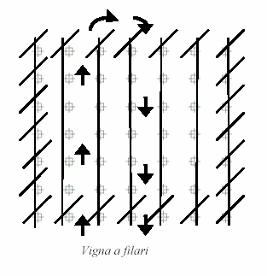
Vineyard Sampling Pattern
Sample from both sides of the row
Avoid edge rows and the two first vines in a row
Estimate the proportion of shaded bunches
and sample accordingly
Collect berries from the top middle and
bottom of the cluster
Good practice to look away from berries when
Sampling so your bias of grabbing a berry with
the best “eye appeal” isn’t influenced.

Slide 11
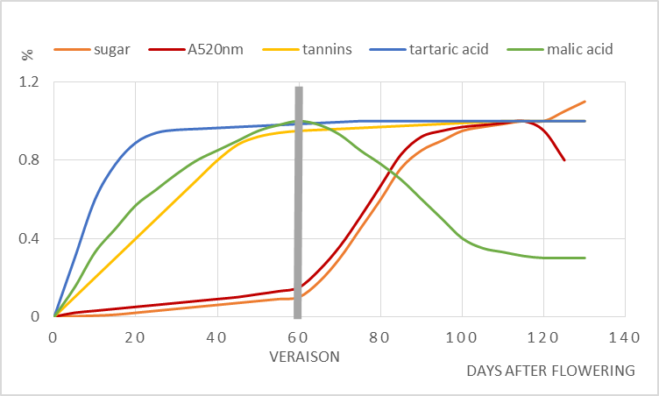
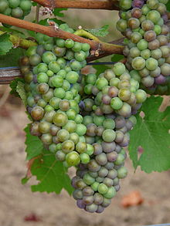
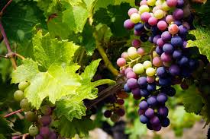
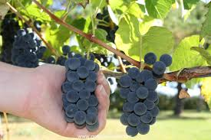
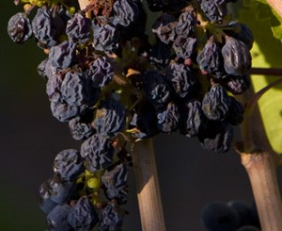
GRAPE MATURATION

Slide 12
Winemaking Process
DECISIONS TO MAKE:
Crush
Crush & De-Stem
De-Stem Only
Whole Cluster
Partial Whole Cluster
Carbonic Maceration
POTENTIAL PROBLEMS:
Oxidation/browning of juice
Microbial contamination
Notes:
- Harvest/Crus/Destem –skins can break and allow unwanted spoilage organisms to get in the fruit – Acetobacter Pediococcus, lactobacillus. These give off aromas and flavors- Protect wit SO2.

Slide 13
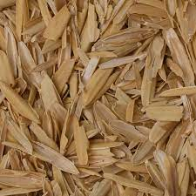
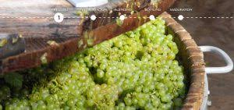
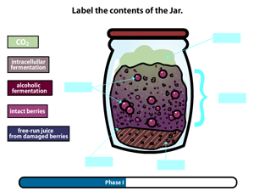
Crush & De-Stem or whole cluster?
This is a matter of personal preference and style of wine you are trying to make
White Wines:
If you are going to crush, consider leaving the stems in for better juice yield
Grapes must be physically ripe, to offset some of the "green" flavors and aromas it will contribute
Rice Hulls as alternative
Red Wines:
Almost always is crushed and de-stemmed
Sometimes a partial whole cluster will be done ex: 30%
Carbonic Maceration (Non-crushed but de-stemmed berries, or can be whole cluster or partial whole cluster –results in lighter & fruiter wines. think- Beaujolais

Slide 14
Importance of SO2

Slide 15
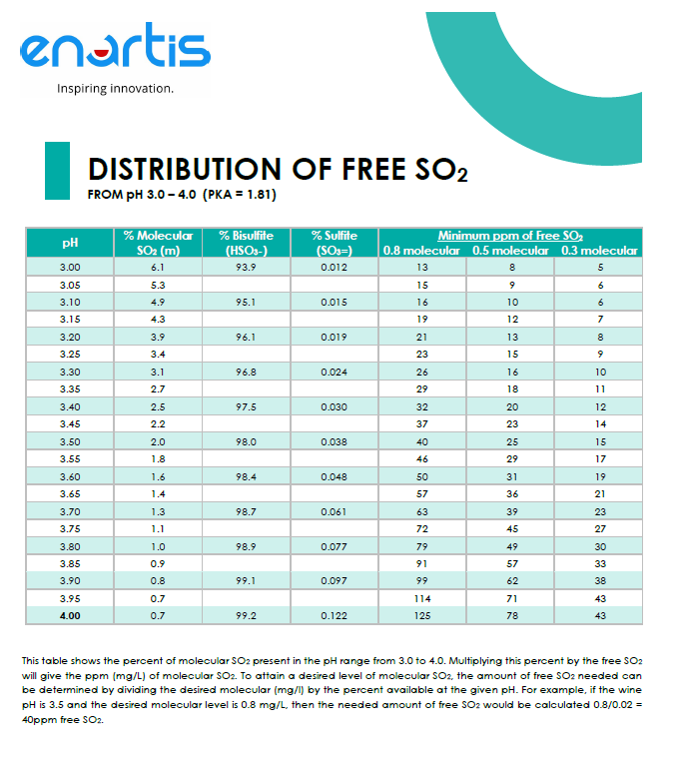
Over pH 3.6 it requires too much SO2 for it to be effective at inhibiting microbial growth
Two Main Functions of SO₂:
1.) Antioxidant Protection
2.) Microbial Inhibitor
Highway to the Danger Zone!
Notes:
This might be one of the most important slides you see all night. The point I want to illustrate here is that efficacy of SO2 or sulfites is pH dependent. The higher the pH the lower the efficacy of SO2 to inhibit microbial growth.
For microbial inhibition it is the molecular part of the SO2 it does not allow microbes to multiply. Depending on the microorganism it can be anywhere from 0.5 to 0.8 molecular lesser 2 that is needed to inhibit the growth of that particular microorganism.
In the case of white wine, let's say you're trying to make a non malolactic chardonnay you would want to keep a molecular SO2 of 0.8. This also is true if you are trying stick a fermentation and leave a wine with a little residual sugar.
In the case of red wine is 0.5 molecular SO2 can keep you safe against Brett. However, it is typically hard to get a 0.8 molecular SO2 on red wines. This is typically because the pH's are higher
Describe how you need to keep a molecular SO2 at those concentrations at all times. And how this is not feasible in wines that are greater than 3.6 pH

Slide 16
Winemaking Process
DECISIONS TO MAKE:
Yeast Strain
Should I use Nutrients?
If so, why & Which ones?
POTENTIAL PROBLEMS:
Stuck or sluggish fermentations
Allow other Microbes to join the party – rising VA's
Notes:
- Harvest/Crus/Destem –skins can break and allow unwanted spoilage organisms to get in the fruit – Acetobacter Pediococcus, lactobacillus. These give off aromas and flavors- Protect wit SO2.

Slide 17
Yeast Selection

Slide 18
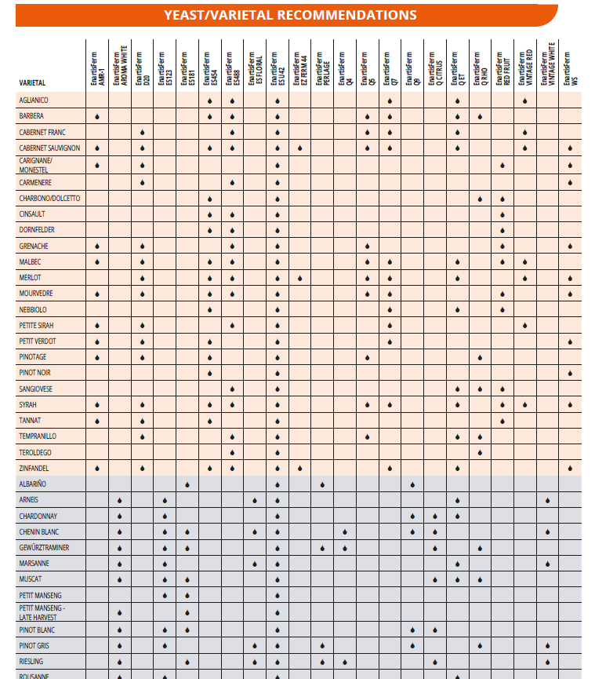
How to Choose a yeast strain?
By Varietal

Slide 19
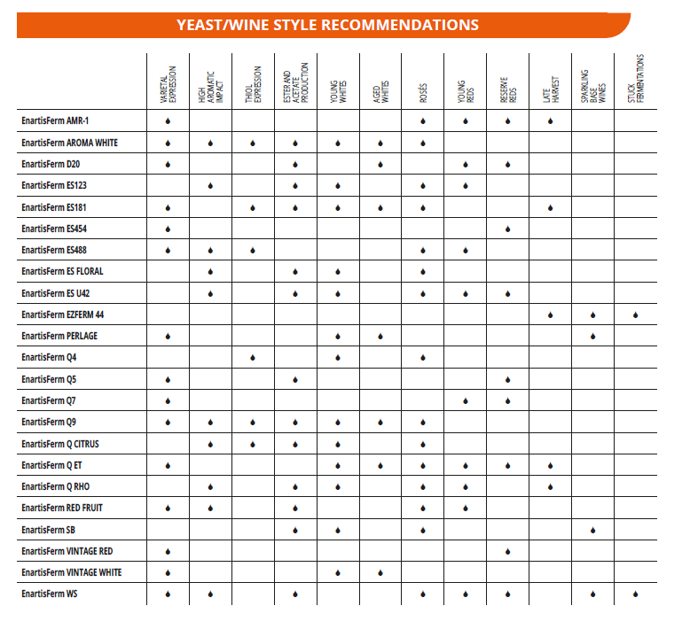
How to Choose a yeast strain?
By Wine Style

Slide 20
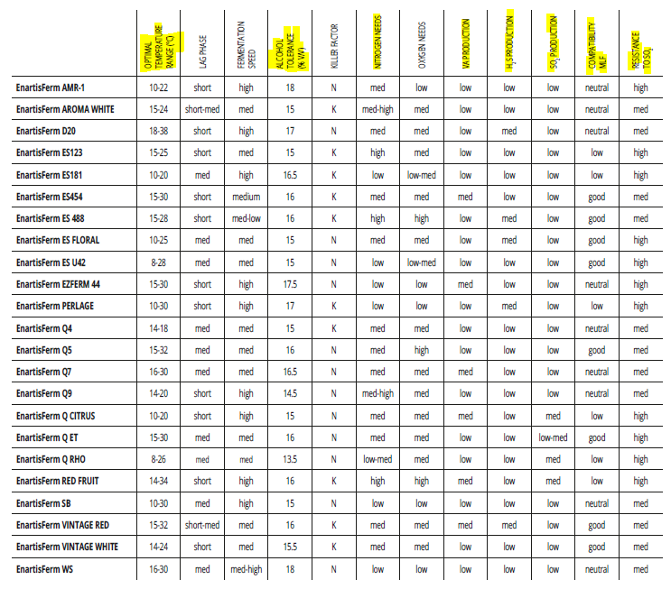
How to Choose a yeast strain?
By Yeast Characteristics

Slide 21
Yeast Nutrition

Slide 22
Yeast nutritive needs
 | Biocheminal function | Enological effet | Addition
NITROGEN | Protein syntheses | - Stimulate yeast multiplication - Prevent H₂S production - Stimulate aromas production (AA's, Not DAP) | Amino Acids: Inoculation DAP: 1/3 sugar depletion
STEROLS AND FATTY ACIDS | Components of yeast cell membrane | - Maintain yeast membrane fluidity - Increase yeast resistance - Reduce off flavors production | 1/3 to 1/2 sugar depletion
THIAMINE | Co-enzyme | - Stimulate yeast growth - Reduce production of SO₂ binding compounds | rehydration
Mg-Zn | Co-enzyme | - Maintain yeast metabolism active | inoculation
Oxygen: 5-10 mg/L during primary fermentation

Slide 23
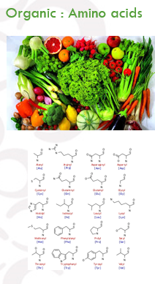
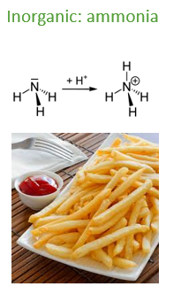
Which form of Nitrogen should i use?
Notes:
The key difference between organic and inorganic nitrogen is that the organic nitrogen is the nitrogen that occurs in organic compounds whereas the inorganic nitrogen is nitrogen that occurs in inorganic compounds. Organic compounds are chemical species containing C and H atom as essential components.
Now, why do we have the

Slide 24
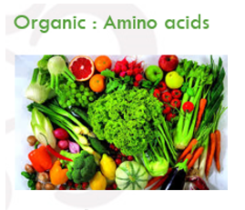
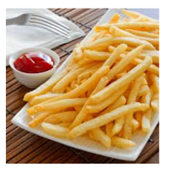
HOW YEAST ABSORB NITROGEN
AMINOACIDS vs AMMONIA
TOO MUCH DAP
DAP LEGAL LIMIT
SALTY TASTE
WINE ACIDIFICATION (H+)
HIGHER VOLATILE ACIDITY ( ETHIL ACETATE)
Becasue other microbes will use it to stimulate their growth too like acetobacter
AMINOACIDS
ESTER PRODUCTION
MORE EFFECTIVE THAN DAP IN PREVENTING H₂S

Slide 25
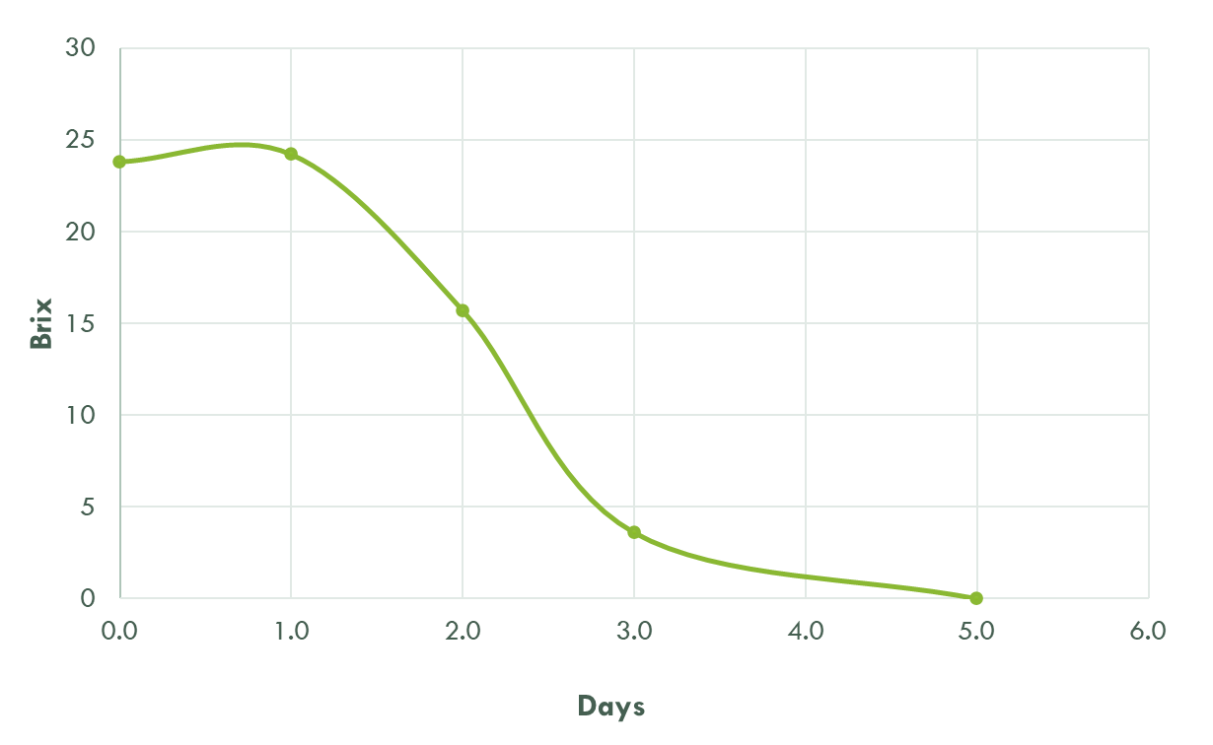
Timing of Nutrient Additions
Inoculation Nutrient
Amino Acid based
2nd Addition Nutrient
DAP
And/Or
STEROLS AND FATTY
ACIDS

Slide 26
Enzymes

Slide 27
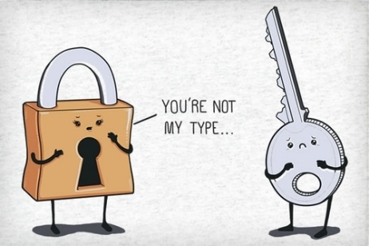
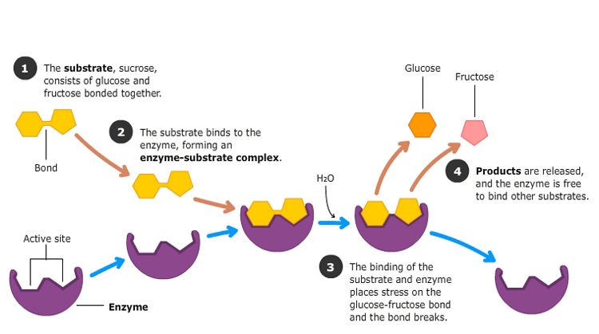
How enzymes work?
Notes:
pH
Acidity
Brix
Pulp
Skin texture, favor, and color is red wine
Berry color

Slide 28
Enzymatic Activity in WIne
 | Enartis Zym RSP | Enartis Zym RS | Enartis Zym Arom MP | Enartis Zym Color Plus | Enartis Zym EZ Filter
Clarification | *** | *** | * |  | *
Clarification of difficult juices | *** | ***
Maceration of white grapes |  |  | ***
Maceration of red grapes |  |  |  | ***
Color stability improvement |  |  |  | ***
Aromatic improvement |  |  | ***
Improve filtration | *** | *** |  |  | ***
Botrytis |  |  |  |  | ***
Notes:
pH
Acidity
Brix
Pulp
Skin texture, favor, and color is red wine
Berry color

Slide 29
Tannins in Winemaking

Slide 30
Uses of Tannins in Winemaking
Grapes / Juice / Fermentation
Antioxidant
Color Stability
Structure Enhancement
Increase Aromatic Intensity
Post Fermentation
Color Stability
Structure Enhancement
Remedial – Reduction and Oxidation
Antioxidant
Maturation / Finishing
Softening mouthfeel
Enhancing structure
Increasing aromatic intensity
Antioxidant

Slide 31
Fining… IS A WHOLE OTHER DISCUSSION

Slide 32
THANK YOU MIKE FAULK ENARTIS USA MICHAEL.FAULK@ENARTIS.COM 707-836-2450

Slide 33
Notes:
pH
Acidity
Brix
Pulp
Skin texture, favor, and color is red wine
Berry color

Slide 34
Winemaking Process
Notes:
- Harvest/Crus/Destem –skins can break and allow unwanted spoilage organisms to get in the fruit – Acetobacter Pediococcus, lactobacillus. These give off aromas and flavors- Protect wit SO2.

Slide 35
Winemaking Process
Notes:
- Harvest/Crus/Destem –skins can break and allow unwanted spoilage organisms to get in the fruit – Acetobacter Pediococcus, lactobacillus. These give off aromas and flavors- Protect wit SO2.

